Slide 1
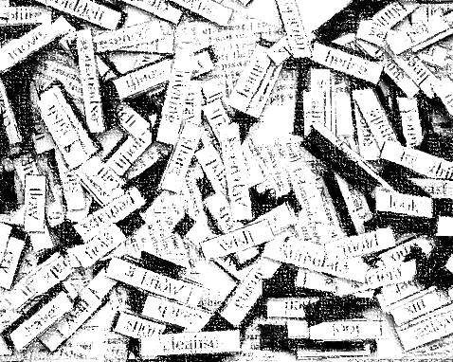
Woorde
Vincent Oliphant

Slide 2

Context of poem
Oliphant wrote poetry during the struggle era where protest poetry was the main theme, though not for him.
He wrote poetry about personal themes.
“Woorde” ➔ commenting on the nature and use of his poetry because he chose not to write protest poetry.
Oliphant distances himself from the struggle that overpowers other poets work in the same era.

Slide 3
Titel: Woorde
Woorde/words
The nature and use of the poets words.
The nature and use of Vincent Oliphant’s words.
It is all about words.

Slide 4
Wat sien ek wanneer ek na die gedig kyk?
4 Strofes:
  Eerste 3 strofes ➔ tersines (3 versreëls)
  Laaste strofe ➔ 11 versreëls
Rymskema is VRYE VERS: No apparent rhyming scheme.
Eerste 3 strofes ➔ Content pretty much the same, that his words can’t do certain things.
GEEN leestekens en GEEN hoofletters nie.

Slide 5
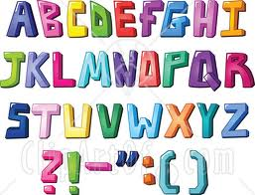
Strofe 1: tersine
my woorde het nie die krag
om bose magte tot ‘n val te bring nie
my woorde kan bloot sing
my woorde is nie ‘n dak
om onder te skuil nie
my woorde is swak
my woorde kan nie keer
dat ons die kromme note haal nie
my woorde is kaal
glo tog
my woorde het nie die byt
van koeëls en grofgeskut nie
nee
my woorde kan bloot bid
en pleit
en wens
medeburgers van die lewe
dat ons van grense sal vergeet
en bloot mens sal wees
en medemens
Strofe 2: tersine
Strofe 3: tersine
Strofe 4: 11 versreëls

Slide 6
Wat sien ek wanneer ek na die gedig kyk?
Die digter (Vincent Oliphant) is die spreker in die gedig.
Herhaling/repetition of “my woorde” ➔ makes for a very personal poem.
HIS OWN WORDS ARE IMPORTANT TO HIM.
“my” repeats 7 times – shows the personal nature of the poem.

Slide 7

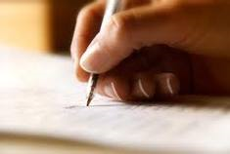
my words do not have the power
to stop the bad or wrong from happening
my words can only sing
my words are not a covering
that you can take shelter under
my words are weak
my words can’t stop us from
getting into trouble
my words are naked/bare
believe still
my words do not have the impact
of bullets or heavy gunfire
no
my words can purely/merely pray
and plead
and wish
fellow countrymen of life
that we will forget the borders/barriers
and only be people
and neighbours

Slide 8
Strofe 1
Sy woorde het nie die krag om die slegte en die verkeerde te stop nie. Sy woorde kan net sing.
my woorde het nie die krag
om bose magte tot ‘n val te bring nie
my woorde kan bloot sing
OO-Alliterasie: Mimic the sound of singing. Sing-song effect.

Slide 9
Strofe 2
Sy woorde is nie ‘n dak waaronder jy kan wegkruip nie, want daarvoor is hulle nie sterk genoeg nie.
Metafoor
my woorde is nie ‘n dak
om onder te skuil nie
my woorde is swak

Slide 10
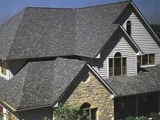
Metafoor
“my woorde is nie ‘n dak/ om onder te skuil nie”
Jy kan nie onder sy woorde wegkruip nie.
Hy sien nie sy woorde as ‘n dak waaronder weggekruip kan word nie.
Die “dak”is metafoor vir “woorde”.

Slide 11
Strofe 3
Sy woorde kan nie keer dat ons in die moeilikheid beland nie, sy woorde is kaal.
my woorde kan nie keer
dat ons die kromme note haal nie
my woorde is kaal
Figuurlike beeld

Slide 12
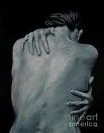
Figuurlike beeld
“my woorde is kaal”
My words are naked. No pretense. I hide nothing within my words.
It portrays his way of writing poetry.
His poems have no unneccesary describing words.
What you see is what you get, no underlying meaning.
Straight forward.

Slide 13
“sing” “swak” “kaal”
Short, one syllable, insignificant words.
Each stanza ends with these verbs:
  Strofe 1 ➔ “sing”
  Strofe 2 ➔ “swak”
  Strofe 3 ➔ “kaal”
His words can only sing, it can’t go over into action, it can’t do anything because it’s weak and nude.
Woorde is in sekere gevalle nutteloos om iets te sê of reg te kry.

Slide 14
Strofe 4
glo tog
my woorde het nie die byt
van koeëls en grofgeskut nie
nee
my woorde kan bloot bid
en pleit
en wens
medeburgers van die lewe
dat ons van grense sal vergeet
en bloot mens sal wees
en medemens
Beklemtoon deur alleenplasing.
Wat sy woorde kan doen.
Dis woorde waarmee hy mense op rustige/kalm manier wil oortuig van sy standpunt.

Slide 15
Polisindeton: repetition of conjunctions in close succession
my woorde kan bloot bid
en pleit
en wens
Function is to emphasise.
A sense of desperation:
NOT my words can merely pray, plead and wish.
BUT my words can merely pray AND plead AND wish.
This is what his word CAN DO!

